Slide 1
Types of Distributed Systems
Cloud Computing
Week 3 and 4 Dr. Rafiullah Khan

Slide 2
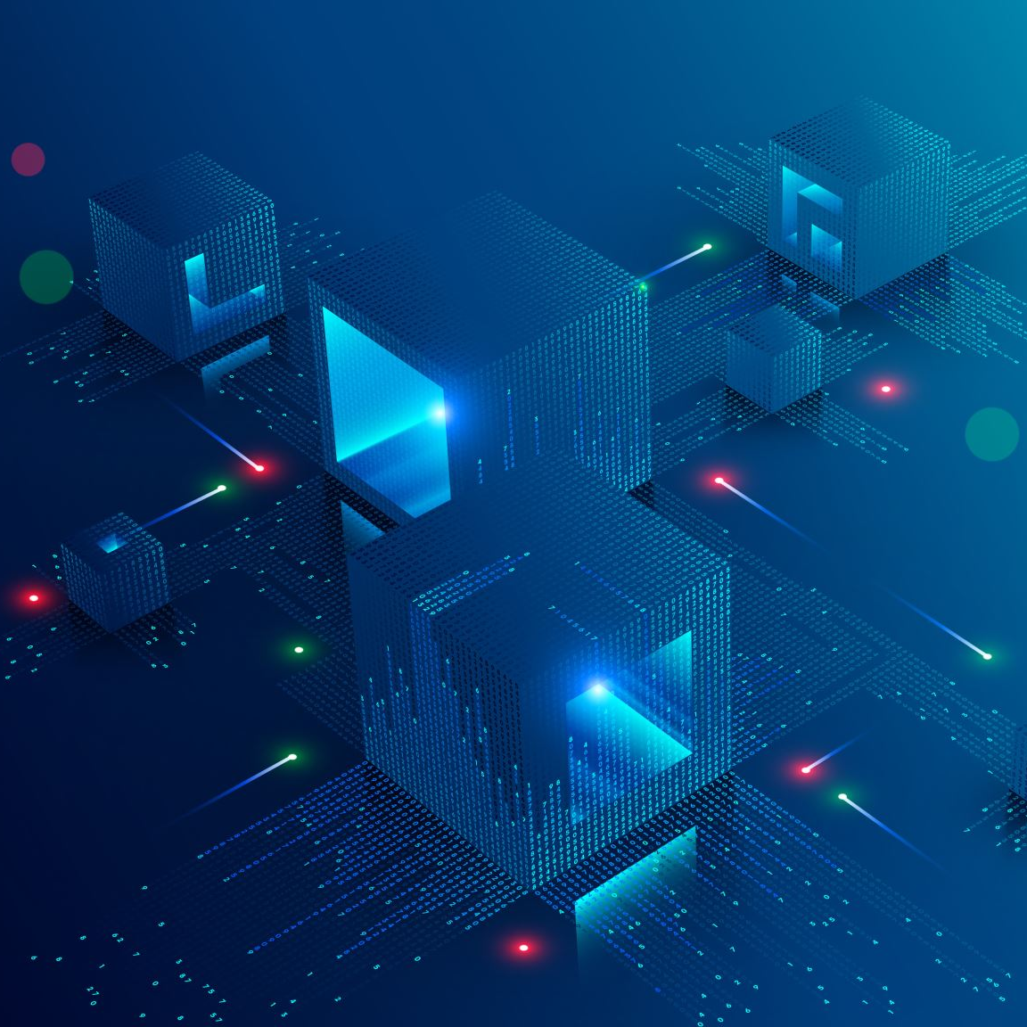
Types of Distributed Systems
Distributed Computing Systems
Clusters
Grids
Clouds
Distributed Information Systems
Transaction Processing Systems
Enterprise Application Integration
Distributed Embedded Systems
Home systems
Health care systems
Sensor networks

Slide 3
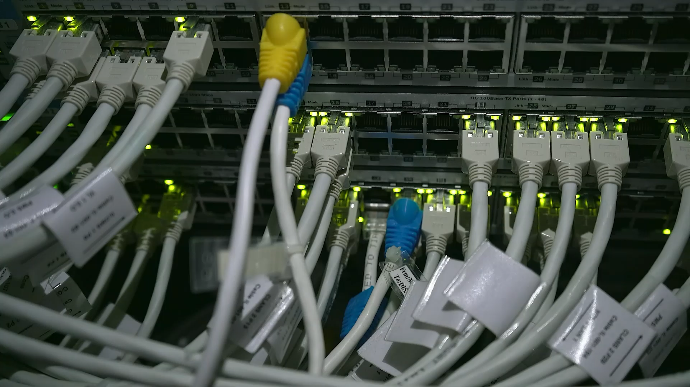
Distributed Computing Systems

Slide 4
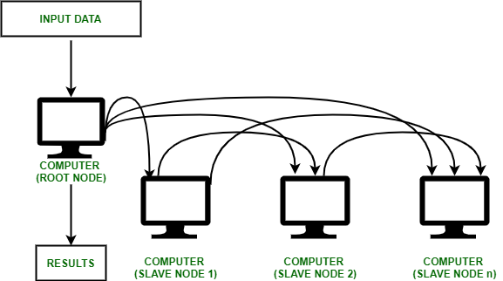
Cluster Computing
A collection of similar processors (PCs, workstations) running the same operating system, connected by a high- speed LAN.
Parallel computing capabilities using inexpensive PC hardware

Slide 5
Cluster Types & Uses
High Performance Clusters (HPC)
run large parallel programs
Scientific, military, engineering apps; e.g., weather modeling
Load Balancing Clusters
Front end processor distributes incoming requests
server farms (e.g., at banks or popular web site)
High Availability Clusters (HA)
Provide redundancy – back up systems
May be more fault tolerant than large mainframes

Slide 6
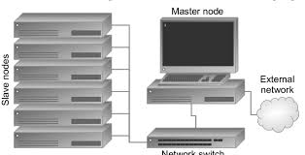
Clusters – Beowulf model
Master-slave paradigm
One processor is the master; allocates tasks to other processors, maintains batch queue of submitted jobs, handles interface to users
Master has libraries to handle message-based communication or other features (the middleware).

Slide 7
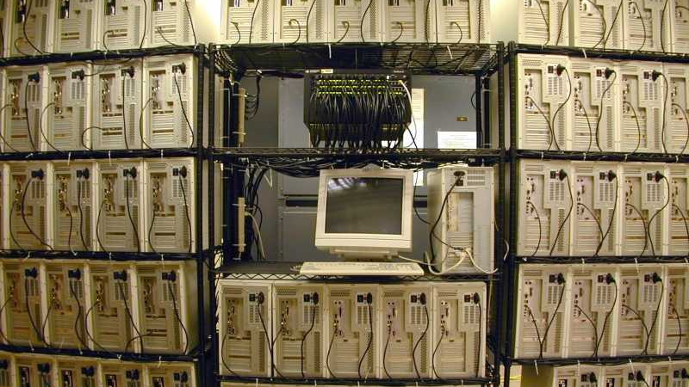
Clusters – Beowulf model at MTU

Slide 8
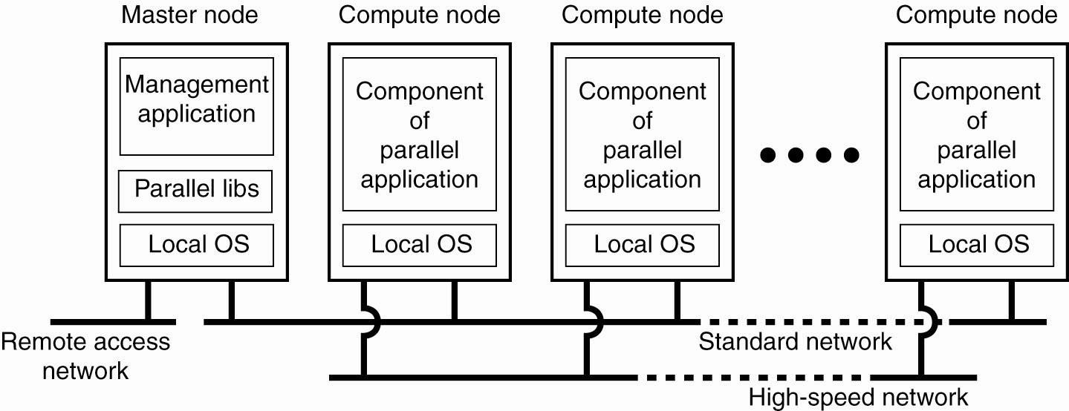
Cluster Computing Systems
Fig
ure 1-6. An example of a cluster computing system
.
An example of a (Beowolf) cluster computing system

Slide 9
Grid Computing Systems
Modeled loosely on the electrical grid.
Highly heterogeneous with respect to hardware, software, networks, security policies, etc.
Grids support virtual organizations: a collaboration of users who pool resources (servers, storage, databases) and share them
Grid software is concerned with managing sharing across administrative domains.
Grid Computing Systems are distributed computing systems in which geographically distributed and heterogeneous computing resources (such as servers, storage, and networks) are connected and coordinated to work together as a single virtual system to solve large-scale computational problems.
In grid computing, resources belonging to different organizations and administrative domains are shared and pooled to achieve high performance and efficiency.
Notes:
Grid Computing Systems are distributed computing systems in which geographically distributed and heterogeneous computing resources (such as servers, storage, and networks) are connected and coordinated to work together as a single virtual system to solve large-scale computational problems.
In grid computing, resources belonging to different organizations and administrative domains are shared and pooled to achieve high performance and efficiency.

Slide 10
Key Characteristics of Grid Computing Systems
Resource Sharing Multiple computers, storage systems, and databases are shared across different locations.
Heterogeneity Grid systems consist of diverse hardware, software, operating systems, and networks.
Geographical Distribution Resources are spread across different locations and organizations.
Virtual Organizations (VOs) Users and institutions collaborate by sharing resources through a virtual organization.
Scalability New resources can be added easily to the grid.
Autonomous Administrative Domains Each participating organization maintains control over its own resources.

Slide 11
Grids
Similar to clusters but processors are more loosely coupled, tend to be heterogeneous, and are not all in a central location.
Can handle workloads similar to those on supercomputers, but grid computers connect over a network (Internet?) and supercomputers’ CPUs connect to a high-speed internal bus/network
Problems are broken up into parts and distributed across multiple computers in the grid – less communication between parts than in clusters.

Slide 12
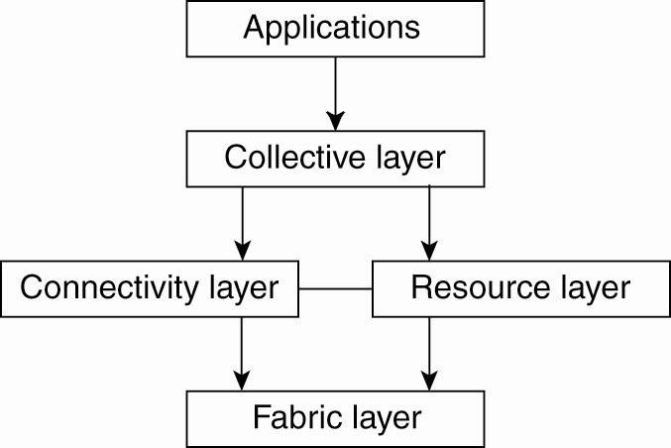
A Proposed Architecture for Grid Systems
Fabric layer: interfaces to local resources at a specific site
Connectivity layer: protocols to support usage of multiple resources for a single application; e.g., access a remote resource or transfer data between resources; and protocols to provide security
Resource layer manages a single resource, using functions supplied by the connectivity layer
Collective layer: resource discovery, allocation, scheduling, etc.
Applications: use the grid resources
The collective, connectivity and resource layers
together form the middleware layer for a grid
A layered architecture for grid computing systems

Slide 13
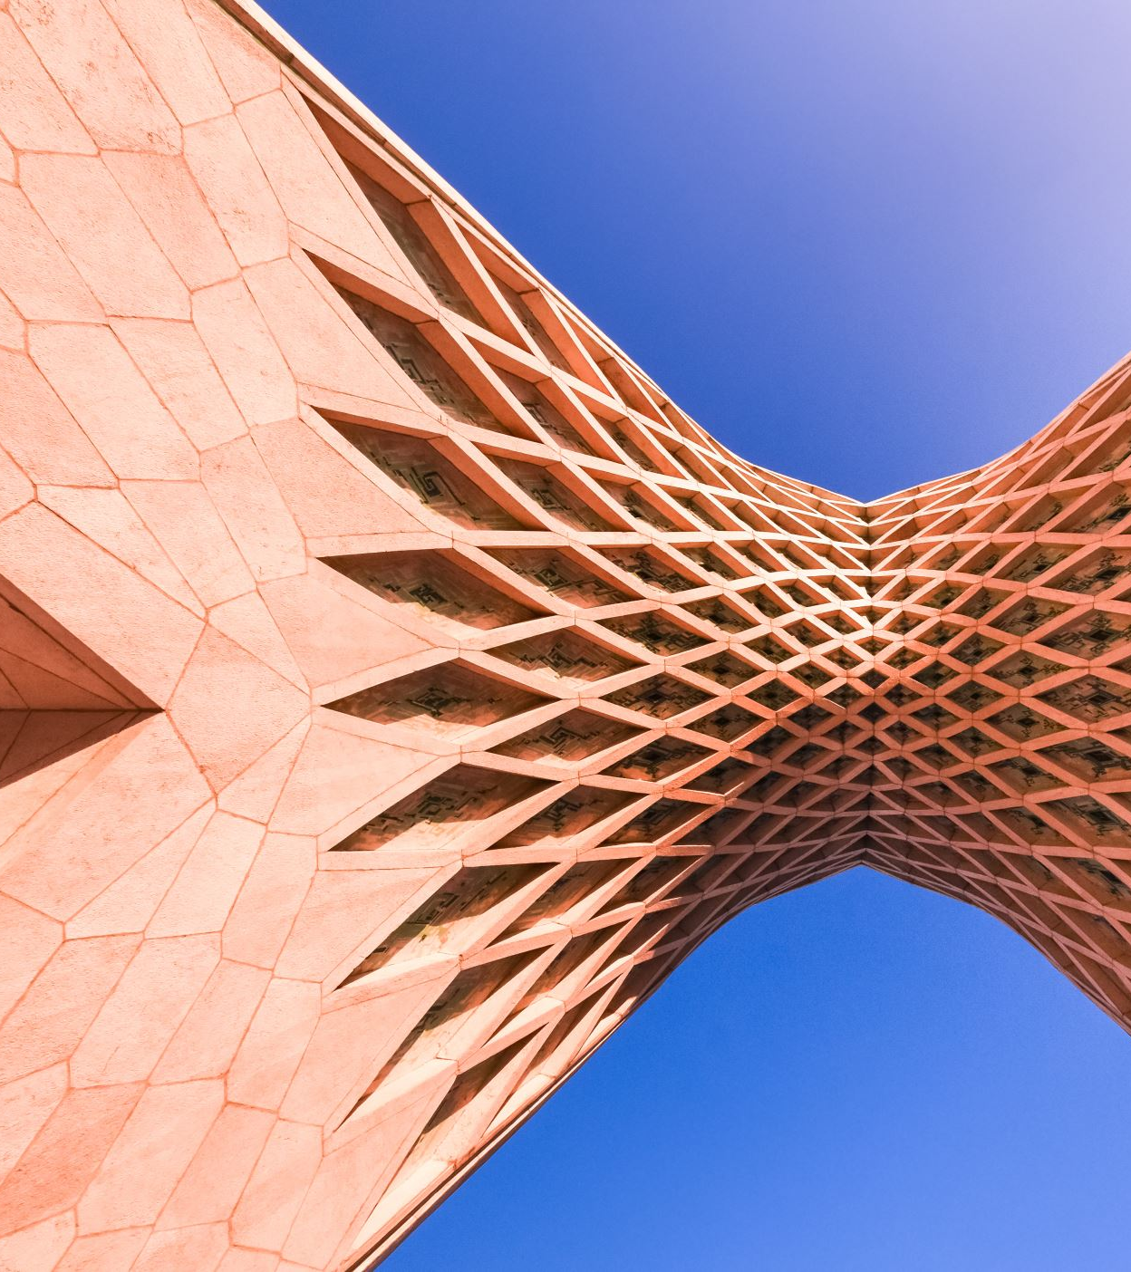
OGSA – Another Grid Architecture
Open Grid Services Architecture (OGSA) is a service- oriented architecture
Sites that offer resources to share do so by offering specific Web services.
The architecture of the OGSA model is more complex than the previous layered model.

Slide 14

Globus Toolkit
An example of grid middleware
Supports the combination of heterogeneous platforms into virtual organizations.
Implements the OSGA standards, among others.

Slide 15

Cloud Computing
The practice of using a network of remote servers hosted on the internet to store, manage, and process data, rather than a local server or a personal computer.
Provides scalable services as a utility over the Internet.
Often built on a computer grid
Users buy services from the cloud
Grid users may develop and run their own software
Cluster/grid/cloud distinctions blur at the edges!

Slide 16
Slides for Students

Slide 17
Types of Distributed Systems
Distributed Computing Systems
Clusters
Grids
Clouds
Distributed Information Systems
Distributed Embedded Systems

Slide 18
Distributed Information Systems
Business-oriented
Systems to make a number of separate network applications interoperable and build “enterprise-wide information
systems”.
Two types discussed here:
Transaction processing systems
Enterprise application integration (EAI)

Slide 19
Transaction Processing Systems
Provide a highly structured client-server approach for database applications
Transactions are the communication model
Obey the ACID properties:
Atomic: all or nothing
Consistent: invariants are preserved
Isolated (serializable)
Durable: committed operations can’t be undone

Slide 20
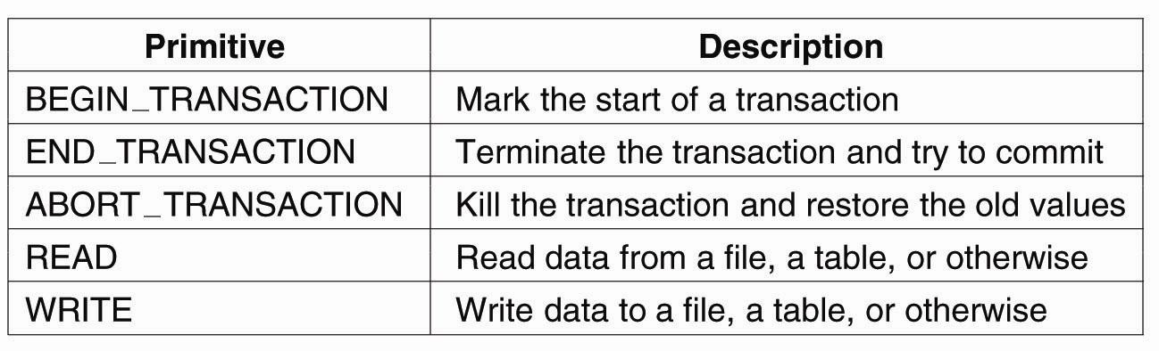
Transaction Processing Systems
Fi
gure 1-8. Example primitives for transactions.
Figure 1-8. Example primitives for transactions

Slide 21
Transactions
Transaction processing may be centralized (traditional client/server system) or distributed.
A distributed database is one in which the data storage is distributed – connected to separate processors.

Slide 22
Nested Transactions
A nested transaction is a transaction within another transaction (a sub-transaction)
Example: a transaction may ask for two things (e.g., airline reservation info + hotel info) which would spawn two nested transactions
Primary transaction waits for the results.
While children are active parent may only abort, commit, or spawn other children

Slide 23
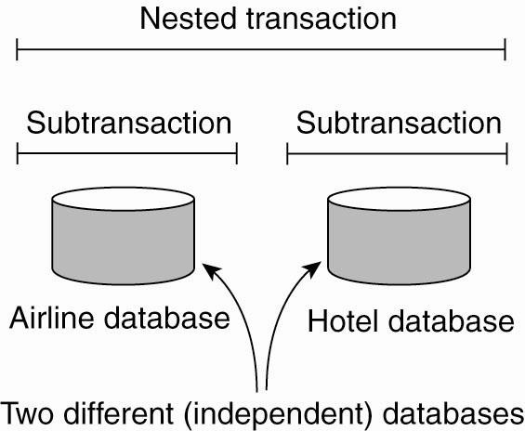
Transaction Processing Systems
Figure: A nested transaction.

Slide 24
Implementing Transactions
Conceptually, private copy of all data
Actually, usually based on logs
Multiple sub-transactions – commit, abort
Durability is a characteristic of top-level transactions only
Nested transactions are suitable for distributed systems
Transaction processing monitor may interface between client and multiple data bases.

Slide 25
Enterprise Application Integration
Less structured than transaction-based systems
EA components communicate directly
Enterprise applications are things like HR data, inventory programs, …
May use different OSs, different DBs but need to interoperate sometimes.
Communication mechanisms to support this include CORBA, Remote Procedure Call (RPC) and Remote Method Invocation (RMI)

Slide 26
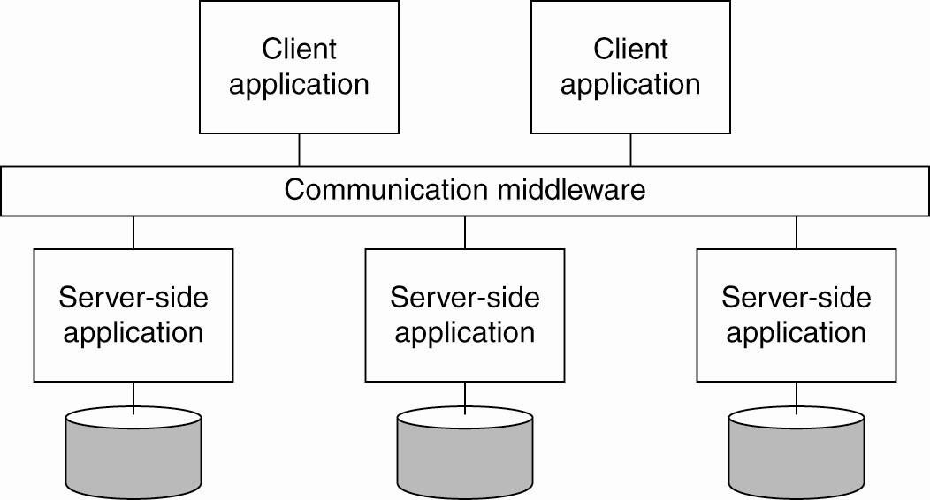
Enterprise Application Integration
Figure: Middleware as a communication facilitator in enterprise application integration.

Slide 27
Distributed Pervasive Systems
The first two types of systems are characterized by their stability: nodes and network connections are more or less fixed
This type of system is likely to incorporate small, battery-powered, mobile devices
Home systems
Electronic health care systems – patient monitoring
Sensor networks – data collection, surveillance

Slide 28
Home System
Built around one or more PCs, but can also include other electronic devices:
Automatic control of lighting, sprinkler systems, alarm systems, etc.
Network enabled appliances
PDAs and smart phones, etc.

Slide 29
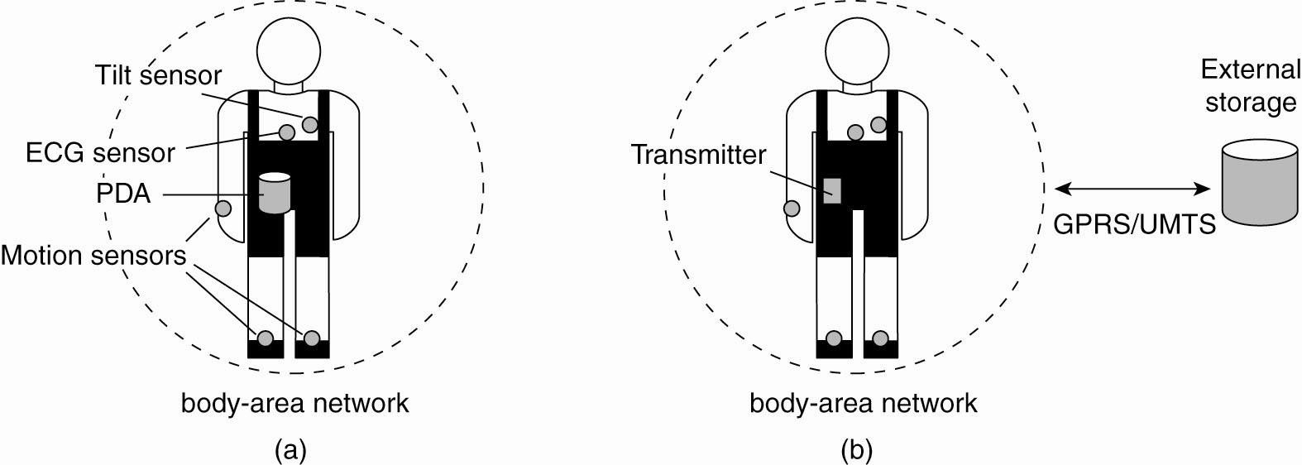
Electronic Health Care Systems
Figure: Monitoring a person in a pervasive electronic health care system, using (a) a local hub or (b) a continuous wireless connection.

Slide 30
Sensor Networks
A collection of geographically distributed nodes consisting of a comm. device, a power source, some kind of sensor, a small processor…
Purpose: to collectively monitor sensory data (temperature, sound, moisture etc.,) and transmit the data to a base station
“smart environment” – the nodes may do some rudimentary processing of the data in addition to their communication responsibilities.

Slide 31
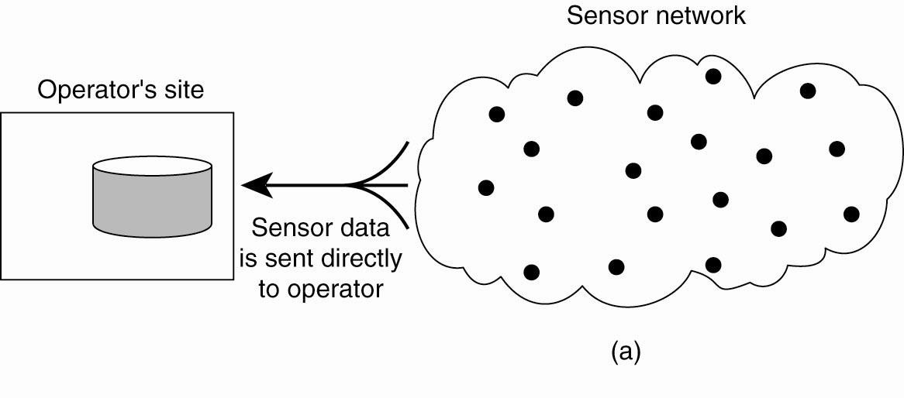
Sensor Networks
Figure 1-13. Organizing a sensor network database, while storing and processing
data (a) only at the operator’s site or …

Slide 32
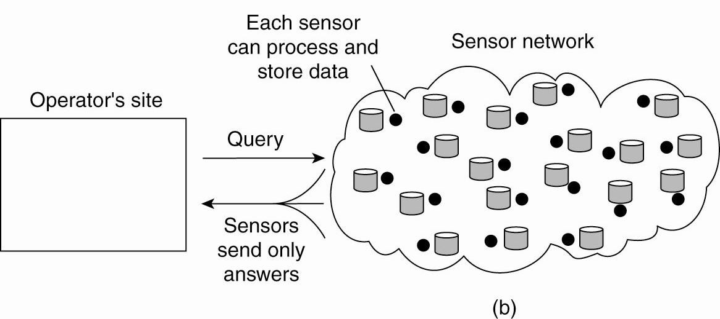
Sensor Networks
Figure 1-13. Organizing a sensor network database, while storing and processing
data … or (b) only at the sensors.

Slide 33
Summary – Types of Systems
Distributed computing systems – our main emphasis
Distributed information systems – we will talk about some aspects of them
Distributed pervasive systems – not so much
****

Slide 34
Additional Slides
Middleware: CORBA, ONC RPC, SOAP
Distributed Systems – Historical Perspective
Grid Computing Sites

Slide 35
CORBA
“CORBA is the acronym for Common Object Request Broker Architecture, OMG's open, vendor-independent architecture and infrastructure that computer applications use to work together over networks. Using the standard protocol IIOP, a CORBA-based program from any vendor, on almost any computer, operating system, programming language, and network, can interoperate with a CORBA-based program from the same or another vendor, on almost any other computer, operating system, programming language, and network.”
http://www.omg.org/gettingstarted/corbafaq.htm

Slide 36
ONC RPC
“ONC RPC, short for Open Network Computing Remote Procedure Call, is a widely deployed remote procedure call system. ONC was originally developed by Sun Microsystems as part of their Network File System project, and is sometimes referred to as Sun ONC or Sun RPC.”
http://en.wikipedia.org/wiki/Open_Network_Computing_Remote_Procedure_Call

Slide 37
Simple Object Access Protocol
SOAP is a lightweight protocol for exchange of information in a decentralized, distributed environment. It is an XML based protocol that consists of three parts: an envelope that defines a framework for describing what is in a message and how to process it, a set of encoding rules for expressing instances of application-defined datatypes, and a convention for representing remote procedure calls and responses. SOAP can potentially be used in combination with a variety of other protocols; however, the only bindings defined in this document describe how to use SOAP in combination with HTTP and HTTP Extension Framework.
http://www.w3.org/TR/2000/NOTE-SOAP-20000508/

Slide 38
Historical Perspective - MPPs
Compare clusters to the Massively Parallel Processors of the 1990’s
Many separate nodes, each with its own private memory – hundreds or thousands of nodes (e.g., Cray T3E, nCube)
Manufactured as a single computer with a proprietary OS, very fast communication network.
Designed to run large, compute-intensive parallel applications
Expensive, long time-to-market cycle

Slide 39
Historical Perspective - NOWs
Networks of Workstations
Designed to harvest idle workstation cycles to support compute-intensive applications.
Advocates contended that if done properly, you could get the power of an MPP at minimal additional cost.
Supported general-purpose processing and parallel applications

Slide 40
Other Grid Resources
The Globus Alliance: “a community of organizations and individuals developing fundamental technologies behind the "Grid," which lets people share computing power, databases, instruments, and other on-line tools securely across corporate, institutional, and geographic boundaries without sacrificing
local autonomy”
Grid Computing Info Center: “aims to promote the development and advancement of technologies that provide seamless and scalable access to wide- area distributed resources”

